Slide 1
Research Dissertation
COMP360
Further Data Analysis and Information Presentation

Slide 2
Objectives for Today
After this session, you should be able to:
Describe how to conduct a power analysis to determine minimal sample size for common data analysis techniques
Import data into R
Conduct basic statistical analyses in R
Suggest the most appropriate graph to use to present data
Produce graphs using fplot() in R

Slide 3
Further Learning
By the end of this module, you should be able to:
Analyze data using R
Interpret and explain inferences that can be made from the output of statistical tests conducted in R
Utilize computational statistics in your research

Slide 4
Objectives for Today
1. Power Analysis
Principles and Measures of Effect Size
Using G*Power
2. Import Data into R
Importing Data into R
3. Data Analysis in R
Correlation
T-tests
Multiple Regression
4. Information Presentation in R
Types of Graph
Using ggplot2 for Simple Charts

Slide 5
Power Analysis
Make Your Work Meaningful!

Slide 6
Statistical Power
The statistical power of a hypothesis test is the probability of making the correct decision if the alternative hypothesis is true. That is, the power of a hypothesis test is the probability of rejecting the null hypothesis when the alternative hypothesis is true.
(Avoiding a Type-II error)

Slide 7
Statistical Power
Consider a usability trial testing two different control schemes for the same game. You might want to know which control scheme contributes to RSI, but unfortunately, only a few cases report problems. You can only test each scheme on a hundred play testers, but only a few in each group suffer serious effects.
A researcher finds their p-value greater than 5%. They write: “There was no statistically significant difference in adverse effects between groups”
Is there likely to be no difference? Discuss.

Slide 8
Statistical Power
Let’s consider a simple scenario to explore:
A gambler is convinced that an opponent has an unfair coin: rather than getting heads half the time and tails half the time, the proportion is different!
How to prove it?
You can’t just flip the coin a hundred times and count the heads. Even with a perfectly fair coin, there won’t be exactly fifty heads because of random error!

Slide 9
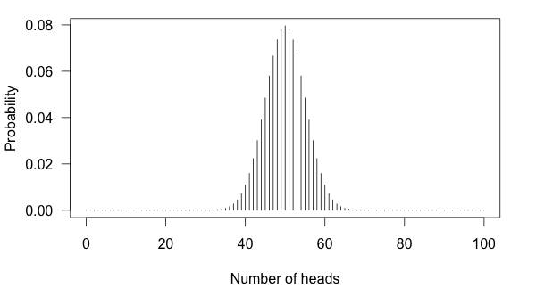
Statistical Power

Slide 10
Statistical Power
The simulation with a fair coin shows:
You can see that 50 heads is the most likely observation.
It’s also reasonably likely to get 43 or 57. The coin might be rigged, but you might just be lucky.
Consider a p-value of 5% --- under the assumption the null hypothesis is true (a fair coin), there is only a 5% chance of observing those numbers, or more extreme values, with a fair coin.
If it’s less than a 5% chance, the it is not a fair coin.
Otherwise, I can conclude nothing.

Slide 11
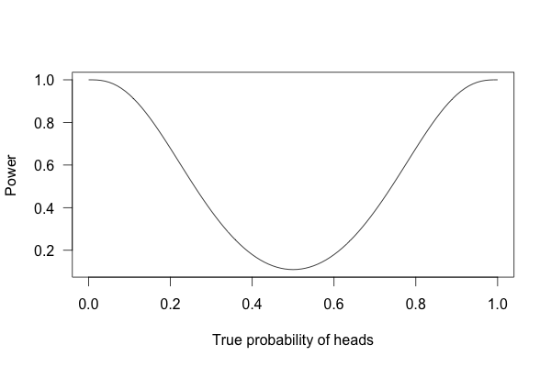

Slide 12
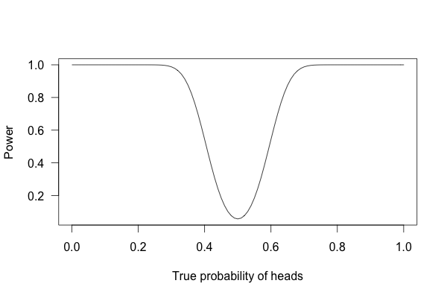

Slide 13
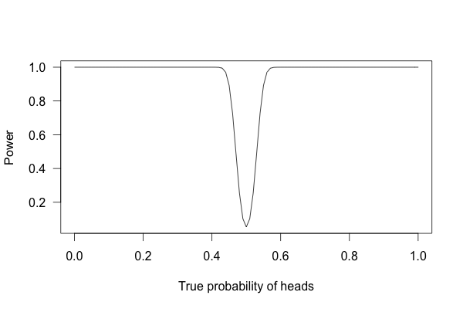

Slide 14
Statistical Power
With one thousand flips, it is easy to determine if the coin is rigged. It is overwhelmingly unlikely that flipping a fair coin 1,000 times will result in more than 600 heads.

Slide 15
Statistical Power
Notes (adapted from Reinhart’s analysis of medical trials):
27% of randomized controlled medical trials that were conducted to find effects on RSI gave negative results, but 64% of these didn’t collect enough data to detect a 50% difference [...] between groups [using different control schemes]. Fifty percent! Even if one [scheme] decreases symptoms by 50% more than the other medication, there’s insufficient data to conclude [that it was safer].

Slide 16
Statistical Power
Now, reconsider the usability trial testing two different control schemes for the same game. You might want to know which control scheme contributes to RSI, but unfortunately, only a few cases report problems. You can only test each scheme on a hundred play testers, but only a few in each group suffer serious effects.
A researcher finds their p-value greater than 5%. They write: “There was no statistically significant difference in adverse effects between groups”
Is there likely to be no difference? This is a Type-II Error due to insufficient sample size!

Slide 17
Statistical Power
The sensitivity of particular statistical tests is known, and they scale with the amount of data being analysed.
Random error cancels itself out as the number of observations is increased.
So, with more data, smaller effect sizes can be reliably detected
Where “reliable” is often considered an 80% chance. If you know the effect size, you can calculate the minimum sample size.

Slide 18
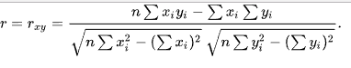
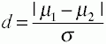
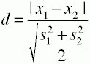
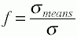
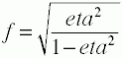
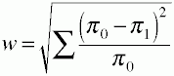
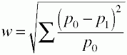
Effect Size
Pearson’s r
Cohen’s d
Cohen’s f-ratio
Cohen’s w

Slide 19
Power Analysis
There are many tools that can be used to determine sample size --- G*Power is the one I recommend for beginners: http://www.gpower.hhu.de/en.html
More sophisticated data analyses can be powered in R using pwr package: https://www.statmethods.net/stats/power.html

Slide 20
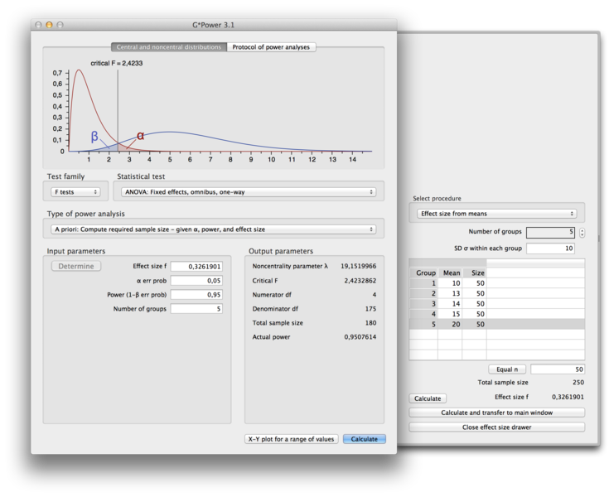

Slide 21
Power Analysis
There are many tools that can be used to determine sample size --- G*Power is the one I recommend for beginners: http://www.gpower.hhu.de/en.html
More sophisticated data analyses can be powered in R using pwr package: https://www.statmethods.net/stats/power.html

Slide 22
Import Data Into R
Prepare for Analysis

Slide 23
Import Data into R
Download and examine
https://www.dropbox.com/s/6x44olpr3kwdkkh/obfuscated_data.csv?dl=1

Slide 24
Import Data into R
To import data from a pre-prepared CSV file, use the following command. Note: Requires the Rcpp module. Run Rstudio in admin mode to install if not available.
> library(readr)
> dat <- read_csv("E:/Stats/obfuscated_data.csv")
To view the data use:
> view(dat)
To see the descriptive statistics for all of the variables in the data use:
> summary(dat)

Slide 25
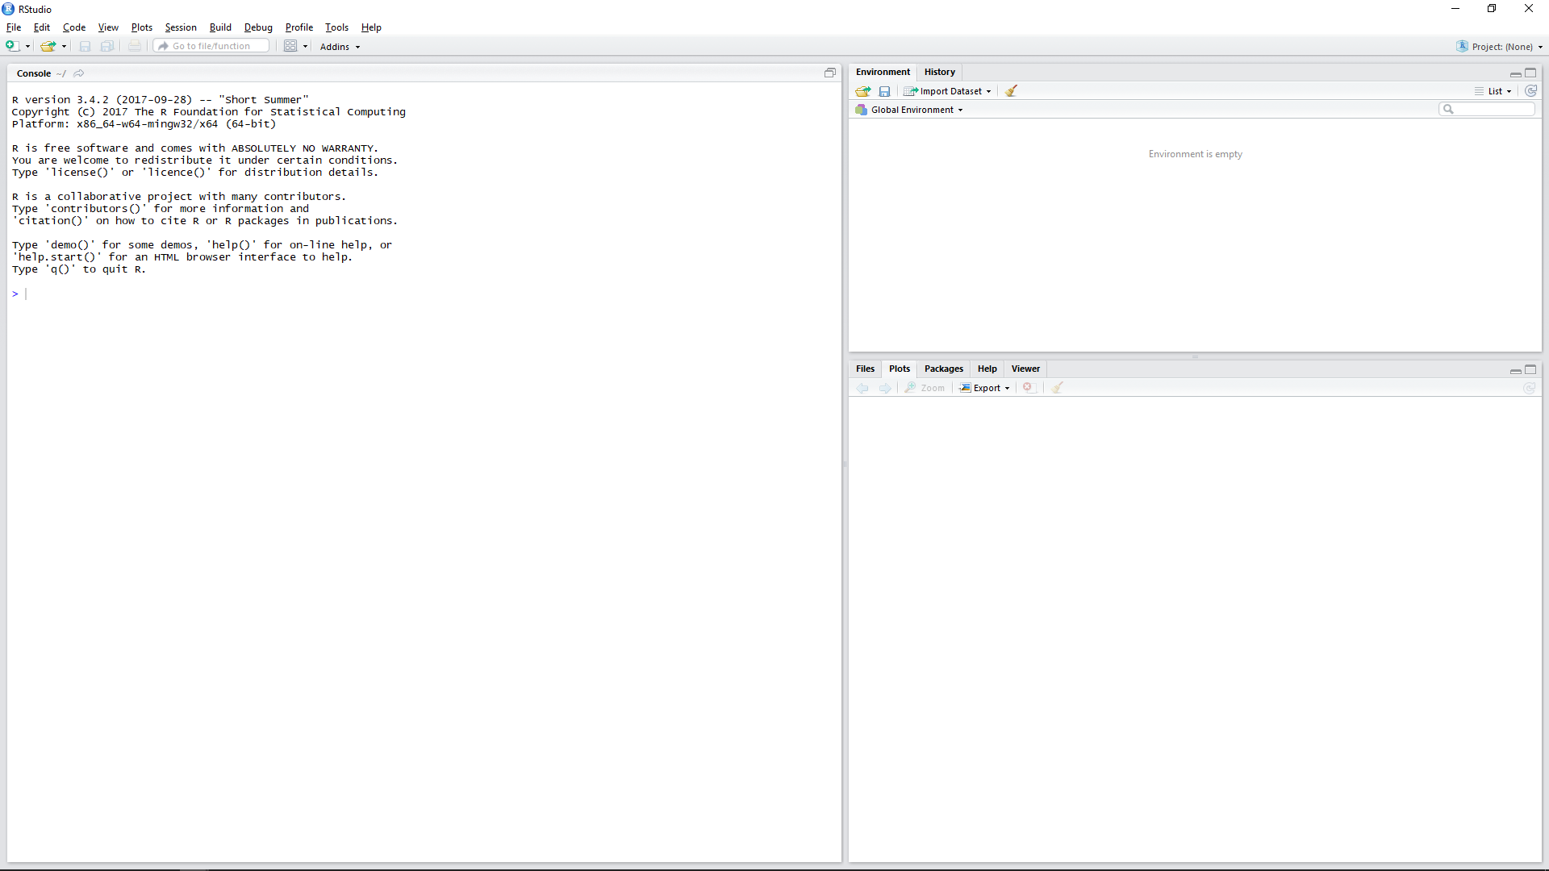
Import Data into R

Slide 26
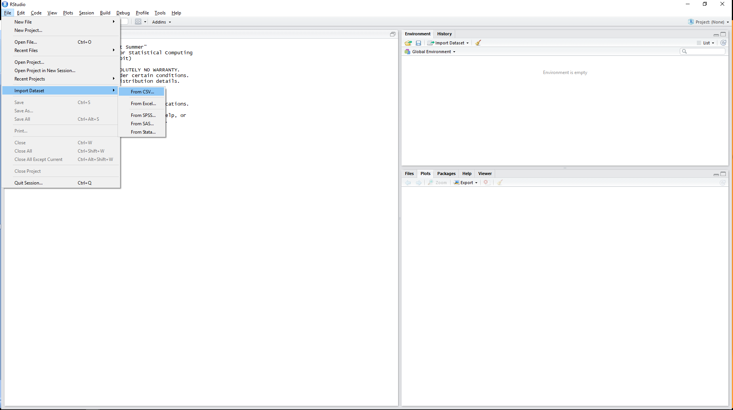
Import Data into R

Slide 27
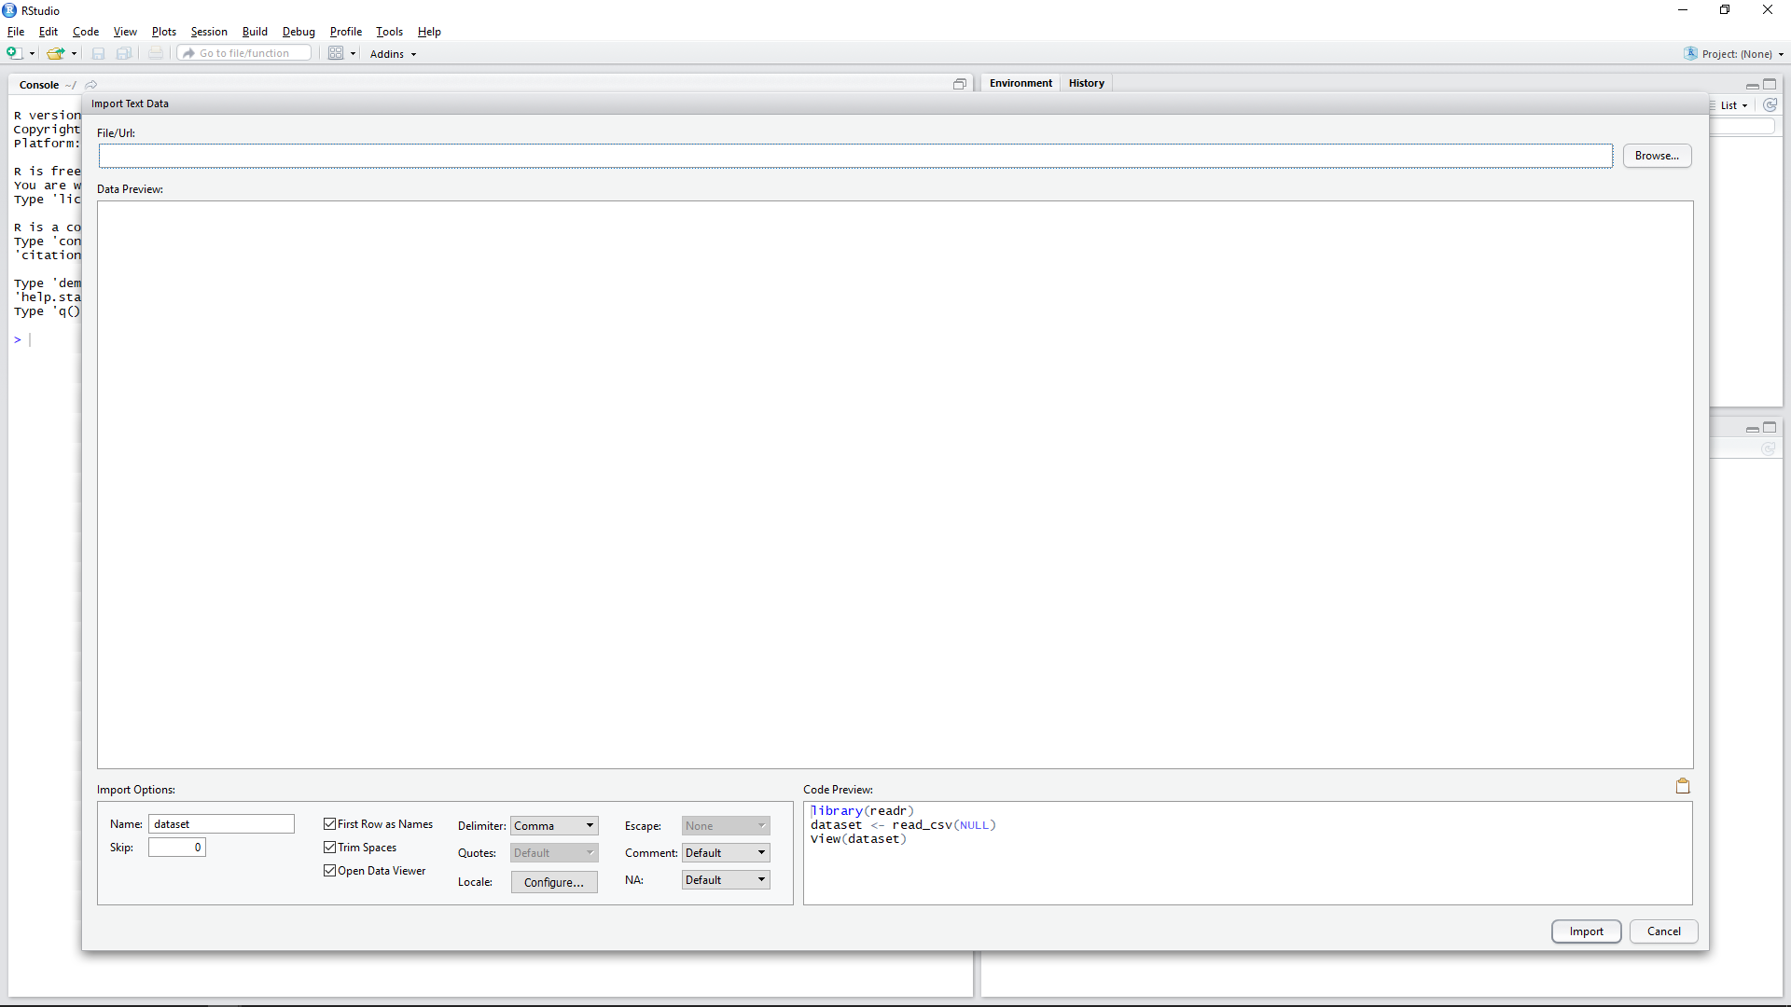
Import Data into R

Slide 28
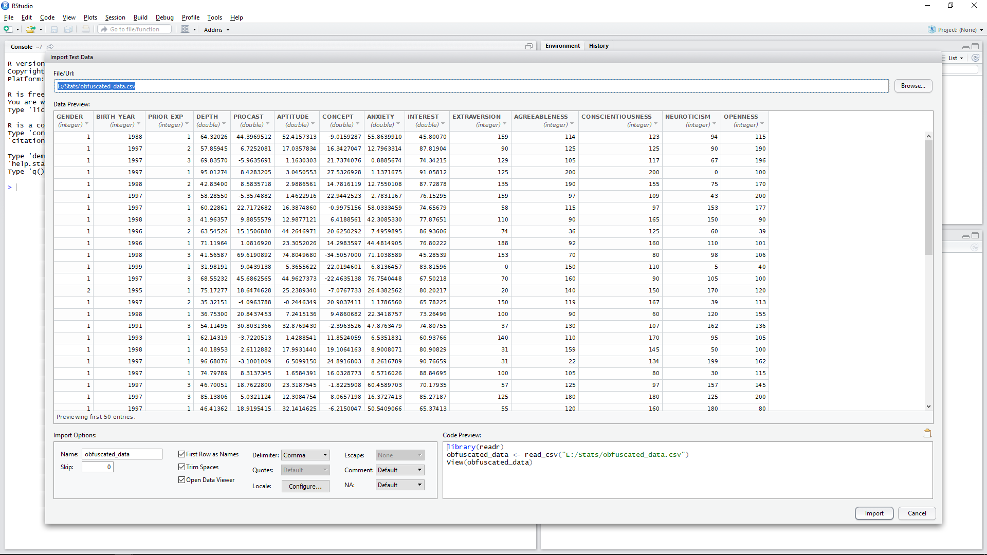
Import Data into R

Slide 29
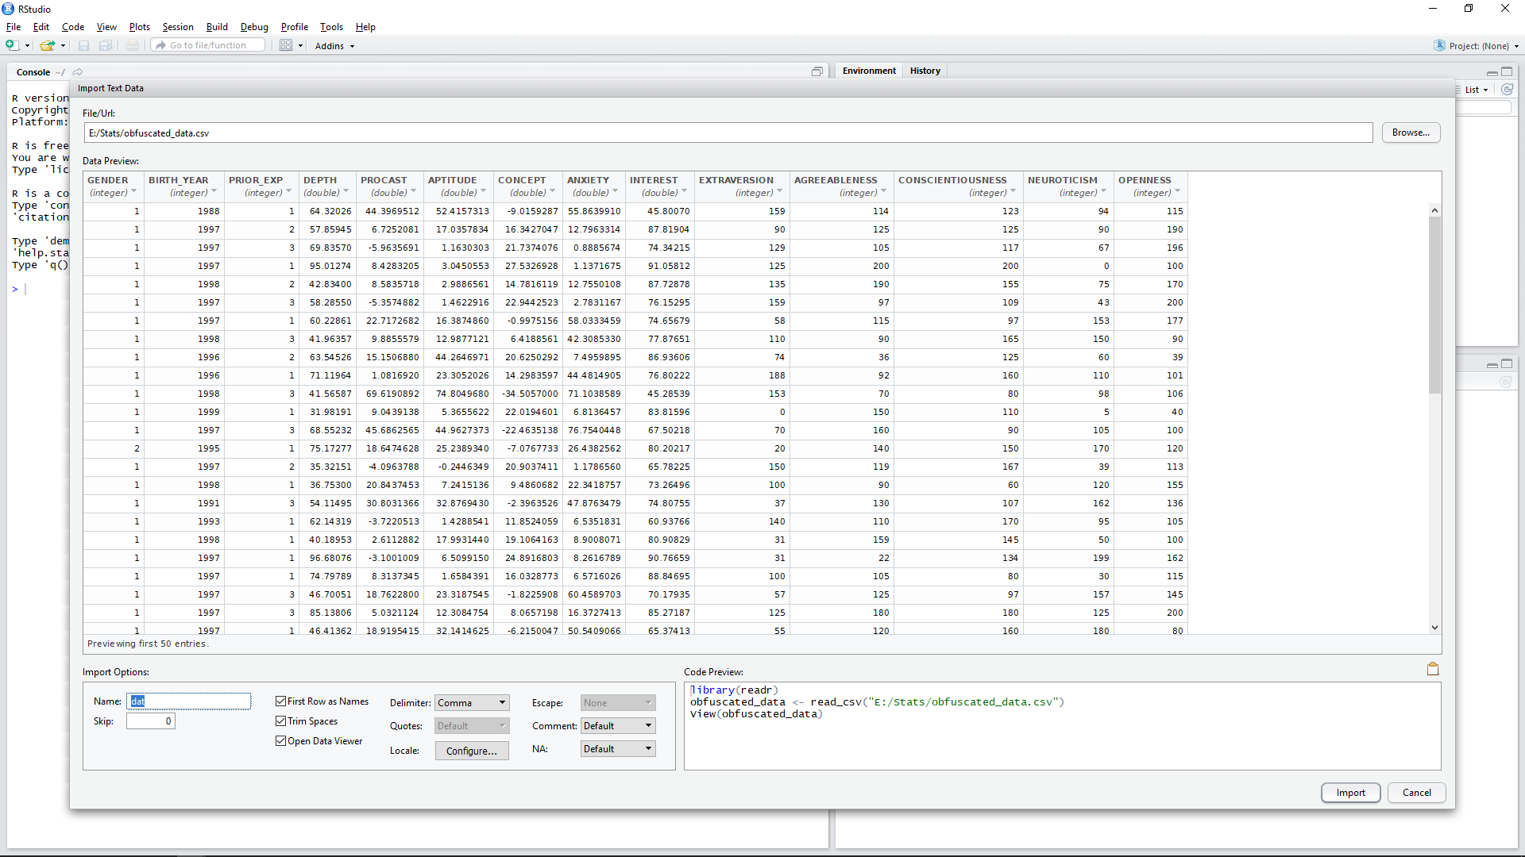
Import Data into R

Slide 30
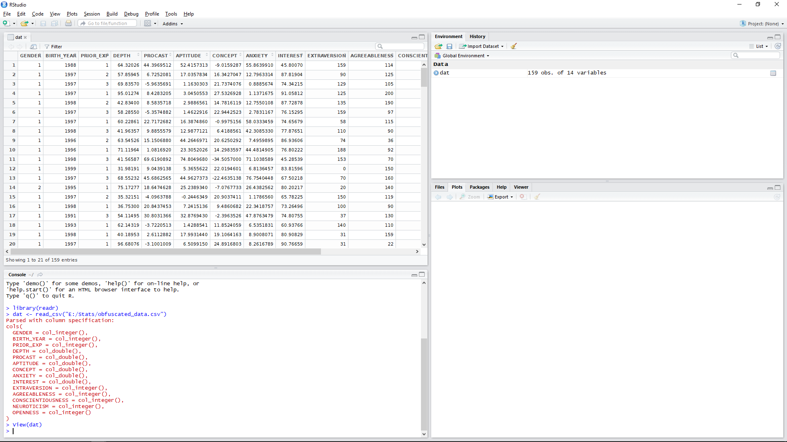
Import Data into R

Slide 31
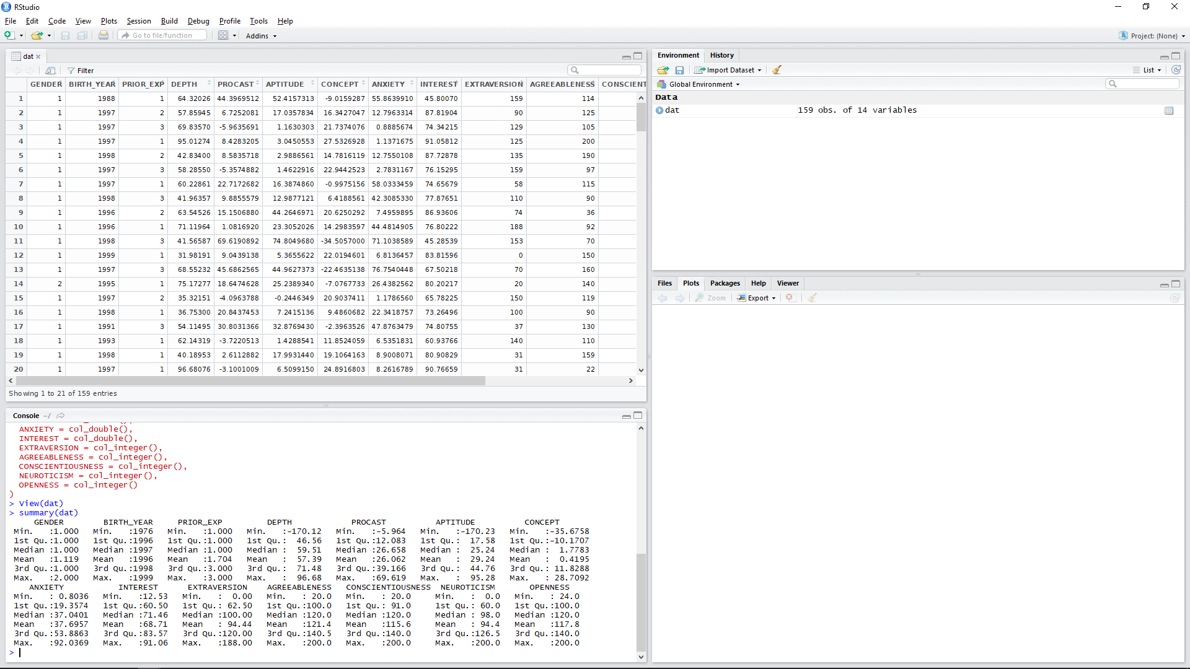
Import Data into R

Slide 32
Data Analysis in R
Illustrating Your Findings

Slide 33
Data Analysis in R
To access a specific variable, use the $ character. It works a bit like the dot operator:
> describe(dat$PROCAST)
Note, some functions such as describe require external libraries to be installed and loaded:
> install.packages(“psych”)
> library(psych)

Slide 34
Correlation
To see a correlation:
> cor(x, y)
> cor.test(x, y, method)
Try:
> cor(dat$PROCAST, dat$APTITUDE, method=“pearson”)
What does “2.2e-16” mean?
What can we conclude from this data?

Slide 35
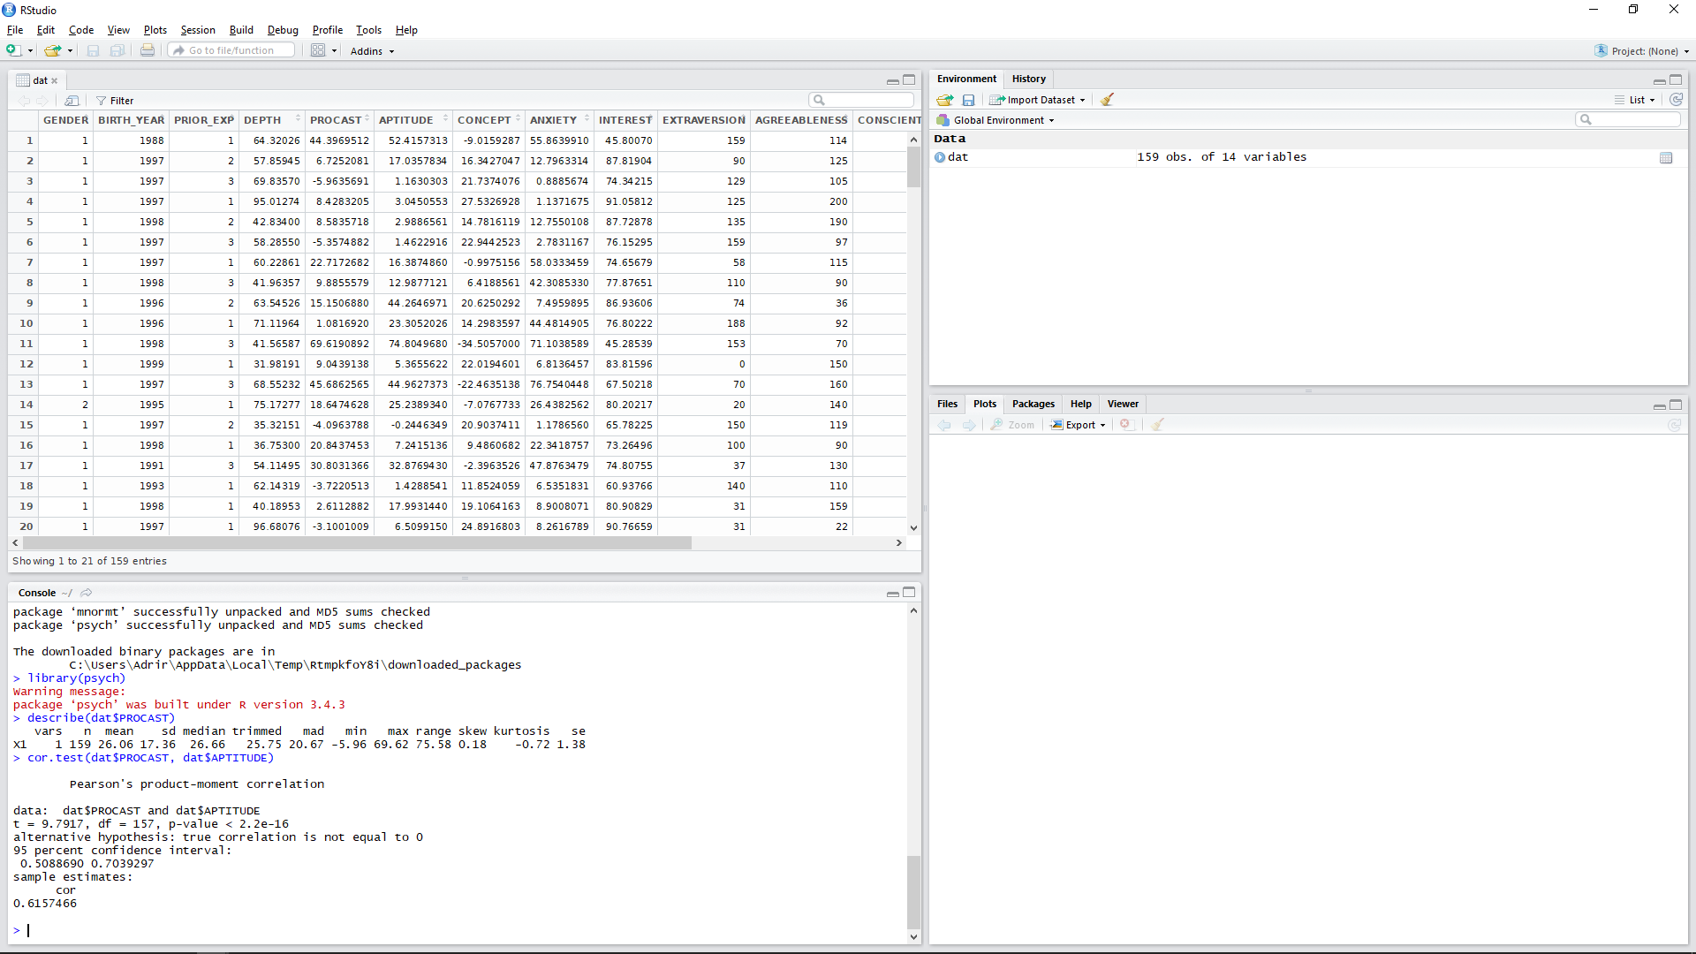
Correlation

Slide 36
T-Test
To see a correlation:
> t.test(x~y)
Note: Data must be in long-format. The tilde indicates the grouping variable.
Try:
> t.test(dat$ANXIETY~dat$GENDER)
What can we conclude from this data?

Slide 37
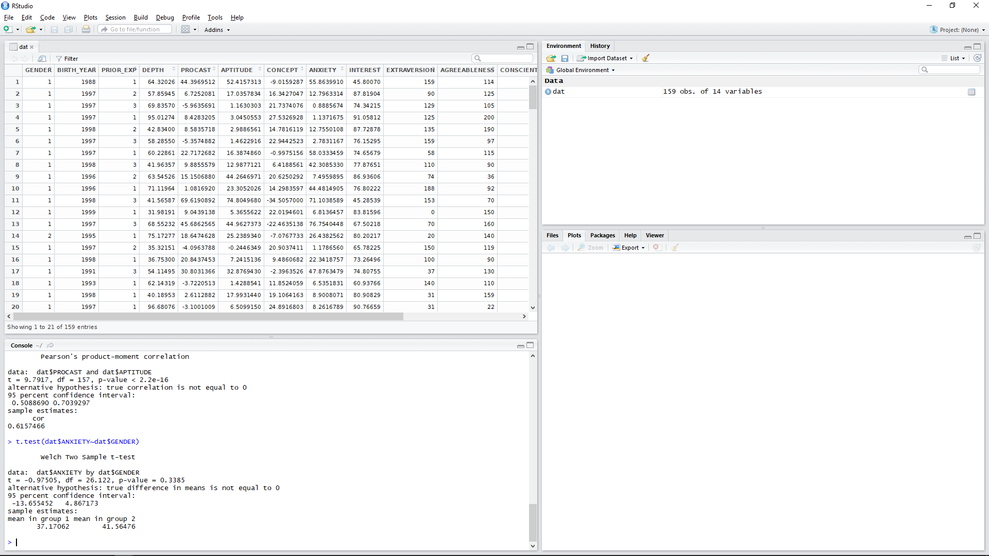
T-Test

Slide 38
Multiple Regression
To regress two independent variables against one dependent variable:
> rm <- lm(dat$ANXIETY ~ dat$NEUROTICISM + dat$APTITUDE)
To view the analysis use:
> summary(rm)
What does these results suggest?
To investigate relative importance of predictors, use:
> library(relaimpo)
> calc.relimp(rm,type=c("pratt"), rela=TRUE)
What happens if you wrap this with the plot() function?

Slide 39
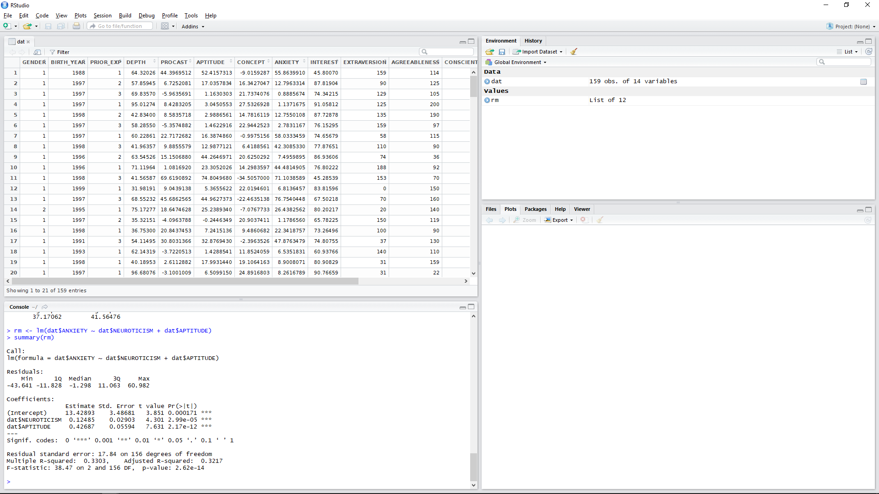
Multiple Regression

Slide 40
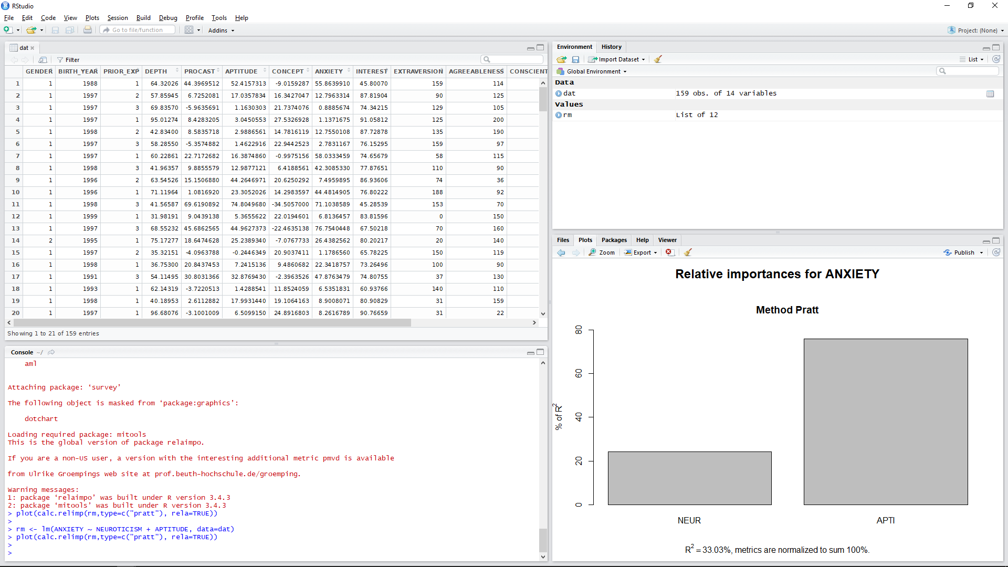
Multiple Regression

Slide 41
Other Analyses
There is a whole host of analyses that can be conducted in Rstudio!
Investigate for yourself those which will have relevance to your particular project.
For resources, see:
www.rdocumentation.org
www.statmethods.net
http://tutorials.iq.harvard.edu/R/
https://support.rstudio.com/hc/en-us

Slide 42
Information Presentation
Illustrating Your Findings

Slide 43
Information Presentation
There are various techniques for reformatting and reducing data to make the analysis more interpretable or to illustrate a key point
Graphical representations will also assist in decision making and reinforce the justification for those decisions --- e.g., has a hypothesis been falsified? To what extent is it clearly falsified?
An overall picture of the data can be gleaned and initial conclusions drawn
Notes:
43

Slide 44
Information Presentation
It is important to select the most effective ways to illustrate your findings in the dissertation
Your communication skills are under assessment --- keep all graphical depiction meaningful to justifying your analysis and/or your intellectual decisions
Provides an overall picture of the data underlying your findings to reach and support your conclusions
Be wary of delegating charts solely to important data:
Depictions can distort message of original data
Concise, but often lacks precision
Ensure adequate support in body of text
Leverage explicit references (e.g., “as shown in Figure 1”)
Notes:
44

Slide 45
Information Presentation
There are many ways of creating graphs in R and Rstudio!
We will use a library called ggplot2, which you may need to install and load
> install.packages("ggplot2", dependencies=TRUE)
> library(ggplot2)
Among its functions should be a qplot(), which covers most of the common charts.
Notes:
45

Slide 46
Information Presentation
Common formats for presenting information include:
Bar Chart
Histogram
Frequency Polygon & Ogive
Pie Chart
Scatter Plot
Box Plot

Slide 47
Do You Know Your Charts and Graphs?
Which chart or graph is associated with which description?
Frequency distribution |  | A circular chart with slices presenting percentage breakdown
Histogram |  | A summary of data presented as classes and frequencies
Ogive |  | A two-dimensional graph of data from two variables
Pie chart |  | A cumulative frequency polygon
Scatter plot |  | A vertical bar chart presenting a frequency distribution
Notes:
47

Slide 48
Bar Chart
A bar chart or bar graph is a chart or graph that presents categorical data with rectangular bars with heights or lengths proportional to the values that they represent.
The bars can be plotted vertically or horizontally.
Bar charts are useful for displaying data that are classified into nominal or ordinal categories in order to make comparisons.

Slide 49
Bar Chart
To a simple bar chart:
> qplot(dat$GENDER, geom="bar", stat="identity")
The geom argument refers to the type of chart that qplot will produce.
The stat argument is depreciated, but useful when no statistical analysis or summary statistic like a mean is needed. For a bar chart, “identify” defaults to a count.

Slide 50
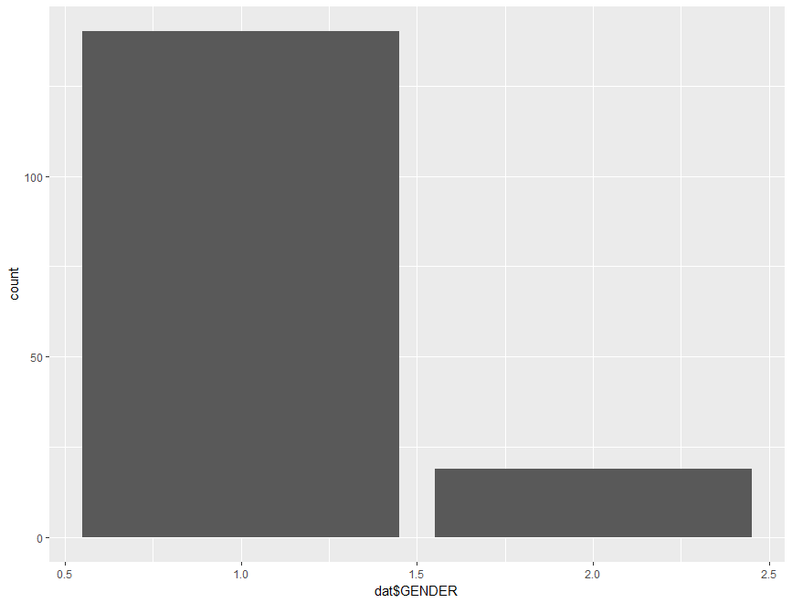
Bar Chart

Slide 51
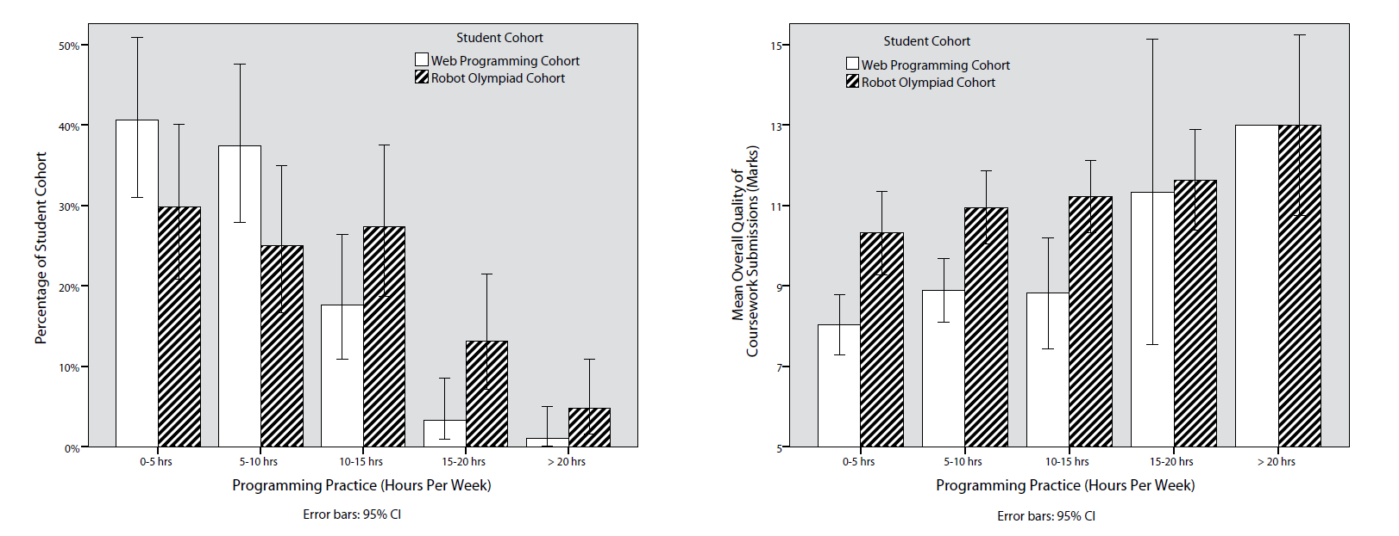
Bar Chart
Bar charts can be made much more complex using other ggplot functions:
http://www.cookbook-r.com/Graphs/Bar_and_line_graphs_(ggplot2)/

Slide 52
Histogram
A type of vertical bar chart used to depict a frequency distribution
Construction steps:
Label the x axis with the class endpoints
Label the y axis with the frequencies
Label the chart with an appropriate title, i.e. not ‘bar chart’
A quick look at the histogram reveals which class intervals produce the highest frequency totals
E.g. which age group most often enrols in undergraduate computing courses?
Notes:
52

Slide 53
Histogram
To display a frequency table, examining birth years from 1975 to 2000 in 5-year intervals, use the following command:
> summary(cut(dat$BIRTH_YEAR, c(1975,seq(1980,2000,5)), include.lowest=T,right=FALSE))
To display a histogram based on this data:
> hist(dat$BIRTH_YEAR, xlab="Year of Birth", ylab="Count", main="Breakdown of Birth Years", breaks=5)
Notes:
53

Slide 54
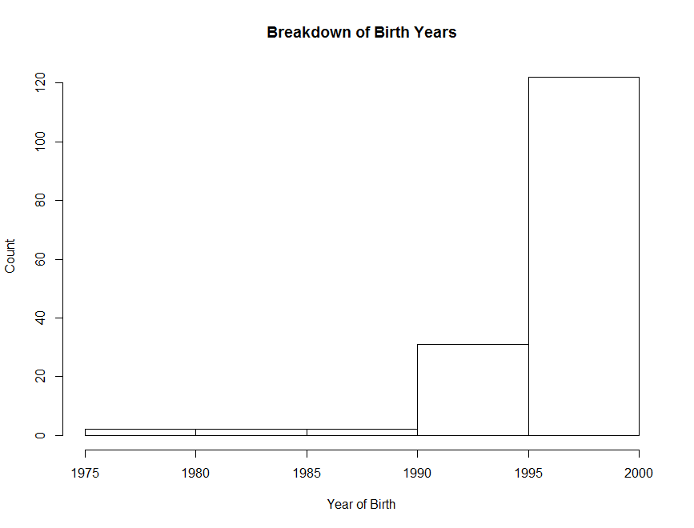
Histogram
Notes:
54

Slide 55
Frequency Polygon
A graph in which line segments connecting the dots depict a frequency distribution
Construction steps:
Label the x axis with the class endpoints
Label the y axis with the frequencies
Plot a dot for the frequency value at the midpoint of each class interval (different to Ogive)
Connect these dots with a line
Notes:
55

Slide 56
Frequency Polygon
To display a histogram of students’ conscientiousness, use the following command:
> ggplot(dat, aes(CONSCIENTIOUSNESS), stat="count") +
geom_freqpoly(binwidth = 20)
Notes:
56

Slide 57
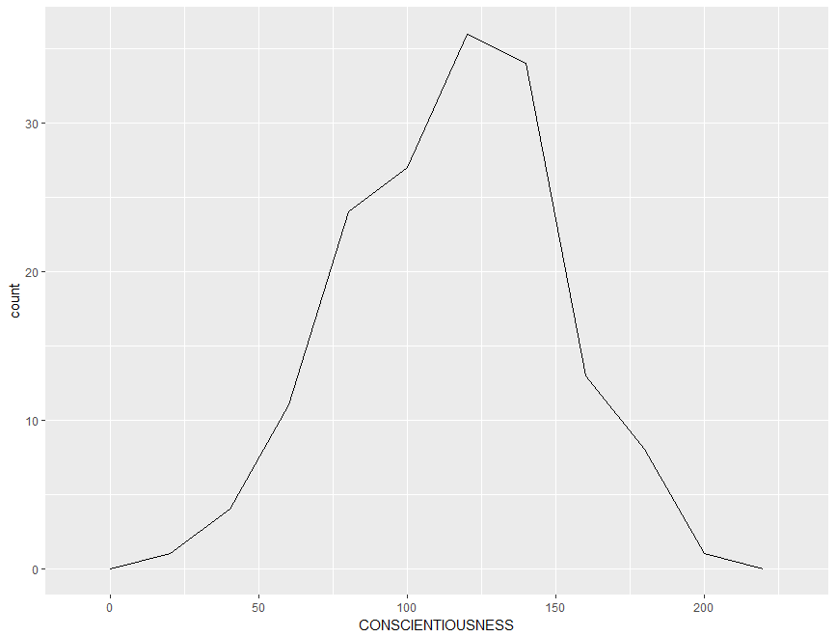
Frequency Polygon
Notes:
57

Slide 58
Ogive
A Cumulative Frequency (CF) polygon
Construction steps:
Label the x axis with the class endpoints
Label the y axis with the cumulative frequencies
A dot of ‘0’ is placed at the beginning of the first class
Mark a dot for the CF value at the end of each class interval
Connect these dots with a line
Notes:
58

Slide 59
Ogive
To construct an ogive, you need to format the data into cumulative frequencies:
> cumfreq0 <- c(0, cumsum(table(cut(dat$CONSCIENTIOUSNESS, seq(0, 240, by=20), right=FALSE))))
Then plot the chart based on this data:
> plot(seq(0, 240, by=20), cumfreq0, main="Range of Conscientiousness", xlab="Level of Conscientiousness", ylab="Cumulative Frequency") + lines(seq(0, 240, by=20), cumfreq0)
Notes:
59

Slide 60
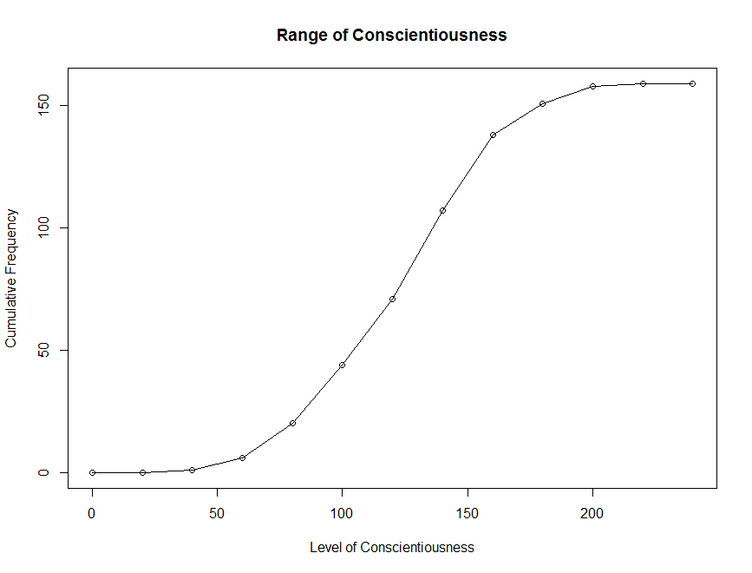
Ogive
Notes:
60

Slide 61
Pie Chart
A circular depiction of data where the area of the whole pie = 100% of the data being studied. Slices represent a % breakdown of each of the values
Business uses: e.g. for depicting budget categories, market share, time and resource allocation
Generally more difficult to interpret the size of the slices compared to the bars in a histogram. But- usage of ‘%’ can clarify slice size
Notes:
61

Slide 62
Pie Chart
Construction steps:
Convert each toothpaste brand amount to a proportion by dividing each individual amount by the total
E.g. 102 / 200 = 0.51
Convert each proportion to degrees by multiplying by 360°
E.g. 0.51 * 360° = 183.6°
Notes:
62

Slide 63
Pie Chart
To construct a pie chart, you first need to label the categories:
> Lbls <- c("Prior Experience with \na Pre-University Qualification", "Prior Experience without \na Pre-University Qualification", "No Prior Experience")
Then plot the pie chart based on this data:
> pie(table(dat$PRIOR_EXP), labels = lbls)
Notes:
63

Slide 64
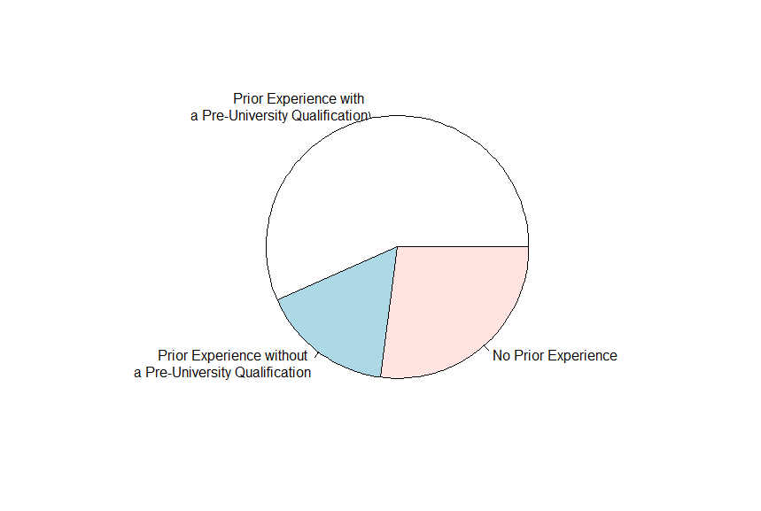
Pie Chart
Notes:
64

Slide 65
Scatter Plot
Illustrates the relationship between two variables based on its underlying data points
E.g. the link between neurotic personality traits and programming anxiety
Scatter graph - a two-dimensional graph plot of pairs of points from two variables
Relationships will vary in strength, line of best fit used to indicate magnitude through slope
Notes:
65

Slide 66
Scatter Plot
For the line of best fit, going to use the rlm() function for a robust linear model to mitigate the influence of dataset outliers:
> library(MASS)
Then using the qplot() command with a combination of geom arguments including “point” (the scatter dots) and “smooth” (the line of best fit.
> qplot(dat$ANXIETY, dat$NEUROTICISM, geom = c("point", "smooth"), method="rlm", main="Correlation between Anxiety and Neuroticism", xlab="Anxiety", ylab="Neuroticism")
Try without the method argument. What happens?
Notes:
66

Slide 67
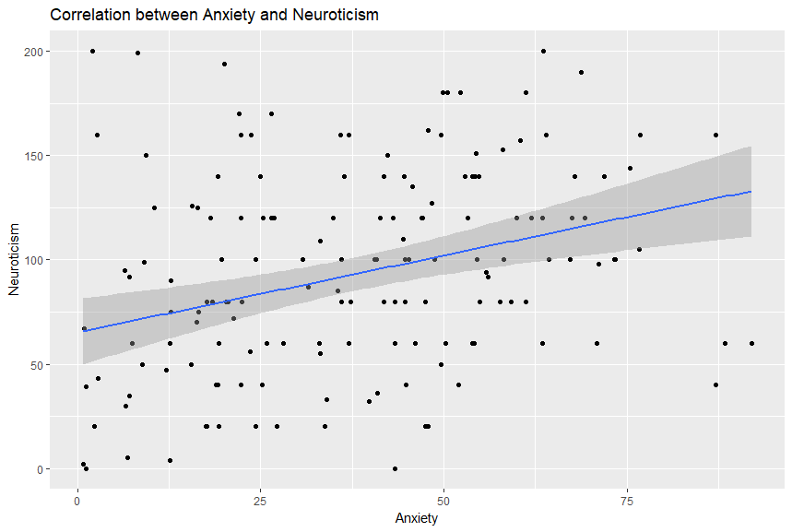
Scatter Plot
Notes:
67

Slide 68
Box Plot
Illustrates proportions of a distribution, and useful for comparing groups
Looking “down” on the distribution from the top, like viewing hills on a plane
Lines outside the box represent range
Box represents the lower and upper quartiles
Line inside the box represents the median
Notes:
68

Slide 69
Pie Chart
Wrapping up commands into a single line:
> qplot(factor(dat$PRIOR_EXP, labels=c("Prior Experience with \na Pre-University Qualification", "Prior Experience without \na Pre-University Qualification", "No Prior Experience")), dat$ANXIETY, geom = "boxplot", main="Anxiety of Students from Different Backgrounds", xlab="Background", ylab="Level of Programming Anxiety")
Take note of the factor() command --- useful for distinguishing between different nominal characteristics or members of experimental and non-experimental groups!
The labels struct is setup in ascending order.
Notes:
69

Slide 70
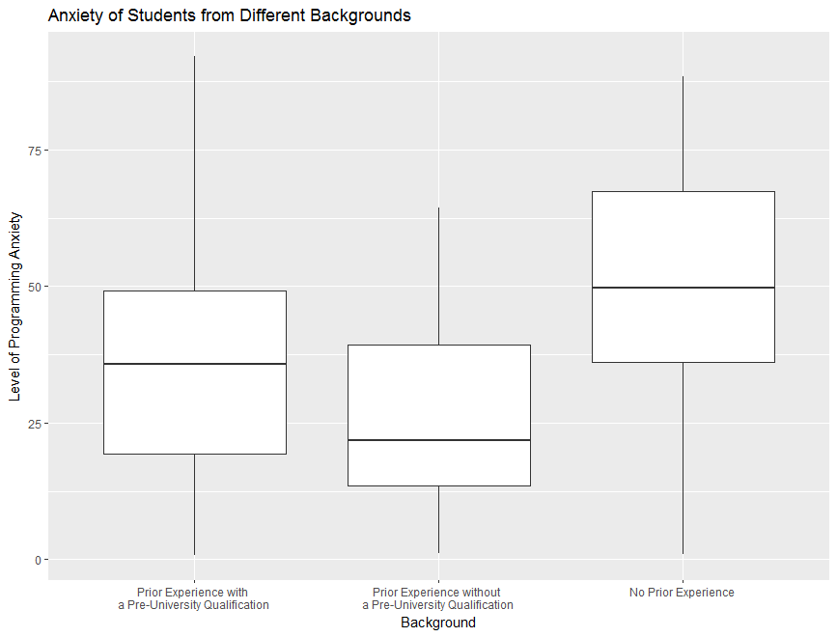
Box Plot
Notes:
70

